Slide 1




SuperBlock
Presentated by SuperDevelopers101

Slide 2




INTRODUCTION
Welcome to the future of finance and e-commerce with SuperBlock

Slide 3





BANKING
Cybersecurity, legacy system modernization, fraud prevention.
INSTANT PAYMENT
Scaling, security, interoperability
The Problems we are tackling
CRYPTO
Regulatory uncertainty, security, market integrity.
BLOCKCHAIN
Scalability, energy efficiency, user experience..

Slide 4



Market Opportunity
Market Size: $20,212.53 billion (over $20 trillion)
Growth Rate: 452.8%
,

Slide 5


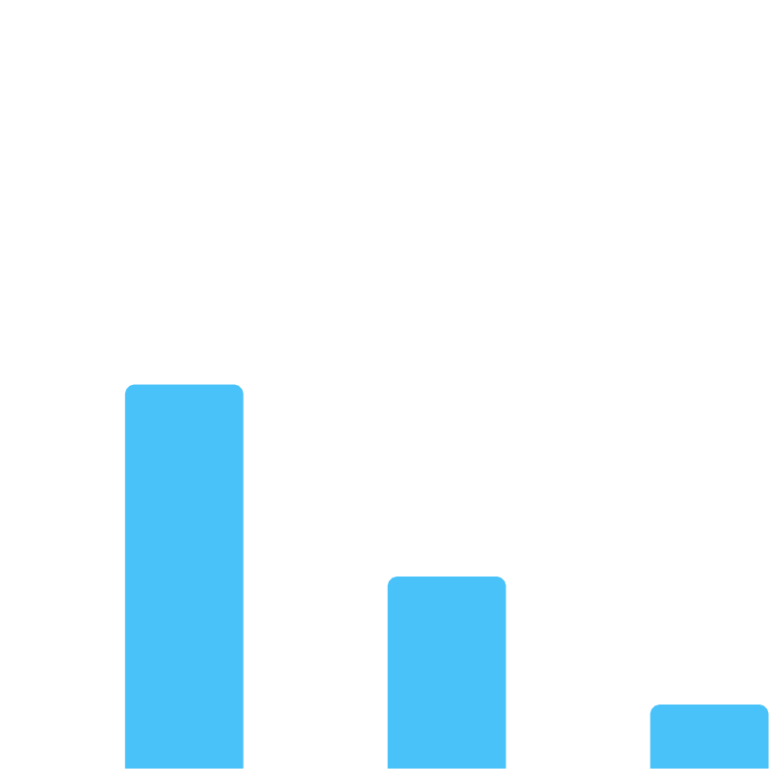
Financial projection
percentage
Revenue
60
50
Year 1 (2024) Revenue Breakdown:
Total Projected Revenue: $50 millionis instant .
40
30
Year 2 (2025)
Targeted Growth:
Projected Revenue: $125 million (150% YoY growth
20
10
0
Payment Gateway E-commerce
Additional Services

Slide 6












Cost Management:
Efficient allocation of resources Optimization of technology investments
1
Risk Management:
Hedging against market volatility
Compliance with regulatory frameworks
2
Financial Strategy
3
Scaling Strategy:
Strategic partnerships for expansion Agile development to capture emerging trends

Slide 7

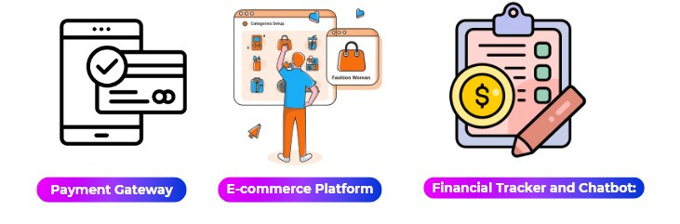

Business Model

Slide 8





Target Market
10%
PAYMENT GATEWAY
$ 30M
20%
E-COMMERCE
$ 15M
ADDITIONAL SERVICES
$ 5M
70%

Slide 9




01
JOIN THE REVOLUTION

Slide 10


Thank you
Contact Us
Questions? Let's connect and innovate together.
SuperBlock - Transforming finance and e-commerce for a brighter future.

